Slide 1
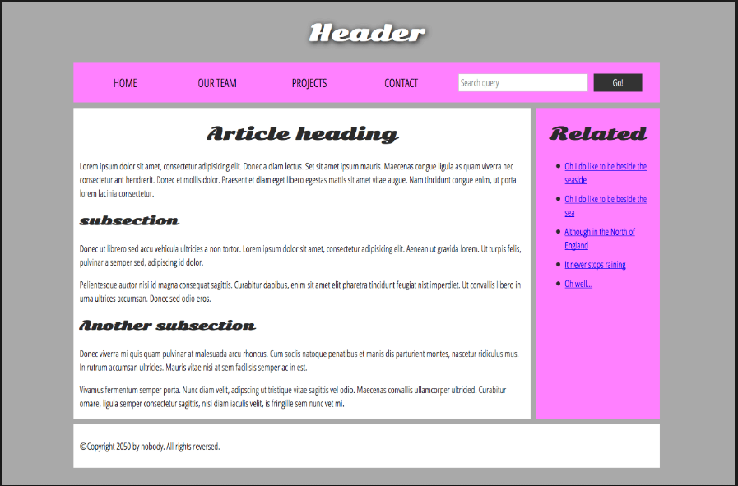

Slide 2

BASIC HTML AND CSS

Slide 3

What is HTML?
HTML is the standard markup language for creating Web pages.
HTML stands for Hyper Text Markup Language.
HTML describes the structure of Web pages using markup.
HTML elements are the building blocks of HTML pages
HTML elements are represented by tags.
HTML tags label pieces of content such as "heading", "paragraph", "table", and so on.
Browsers do not display the HTML tags, but use them to render the content of the page.

Slide 4

Basic html format
<html>
<head>
<title>Page Title</title>
</head>
<body>
<h1>My First Heading</h1>
<p>My first paragraph.</p>
</body>
</html>

Slide 5
HTML Tags:
HTML tags are element names surrounded by angle brackets:
<tagname>content goes here...</tagname>
HTML tags normally come in pairs like <p> and </p>
The first tag in a pair is the start tag, the second tag is the end tag
The end tag is written like the start tag, but with a forward slash inserted before the tag name

Slide 6
HTML Versions:
VERSIONS | YEAR
HTML | 1991
HTML 2.0 | 1995
HTML 3.2 | 1997
HTML 4.01 | 1999
XHTML | 2000
HTML 5 | 2014

Slide 7
HTML Elements:
An HTML element usually consists of a start tag and end tag, with the content inserted in between:
<tagname>Content goes here...</tagname>
The HTML element is everything from the start tag to the end tag:
<p>My first paragraph.</p>
HTML elements with no content are called empty elements. Empty elements do not have an end tag, such as the <br> element (which indicates a line break).

Slide 8
HTML Attributes:
All HTML elements can have attributes
Attributes provide additional information about an element
Attributes are always specified in the start tag
Attributes usually come in name/value pairs like: name="value"
Example
<a href="https://www.example.com">This is a link</a>

Slide 9
HTML Headings:
Headings are defined with the <h1> to <h6> tags.
<h1> defines the most important heading. <h6> defines the least important heading.
<h1>Heading 1</h1> <h2>Heading 2</h2> <h3>Heading 3</h3> <h4>Heading 4</h4> <h5>Heading 5</h5> <h6>Heading 6</h6>

Slide 10
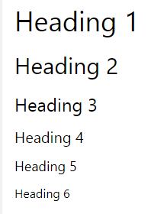

Slide 11
HTML Paragraphs:
The HTML <p> element defines a paragraph:
Example
<p>This is a paragraph.</p> <p>This is another paragraph.</p>

Slide 12
HTML Links – Hyperlinks:
You can click on a link and jump to another document.
When you move the mouse over a link, the mouse arrow will turn into a little hand.
Note: A link does not have to be text. It can be an image or any other HTML element.
In HTML, links are defined with the <a> tag:
<a href="url">link text</a>

Slide 13
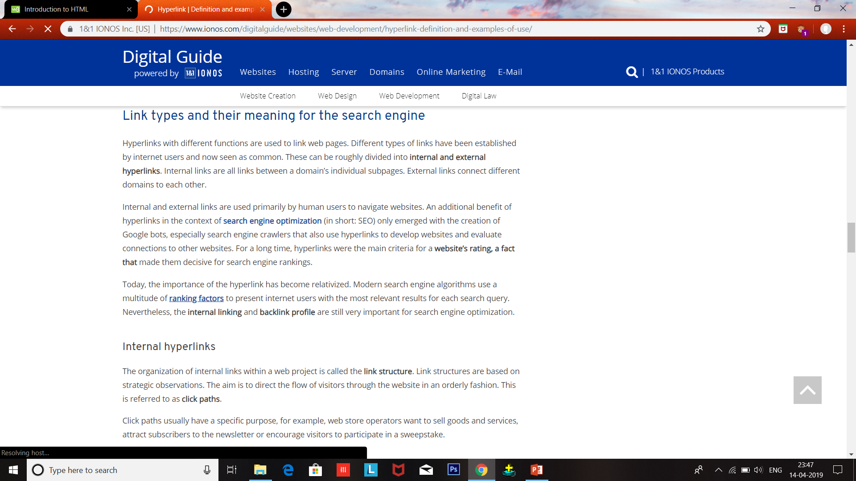
Hyperlink example
Hand symbol

Slide 14
HTML Images Syntax:
In HTML, images are defined with the <img> tag.
The <img> tag is empty, it contains attributes only, and does not have a closing tag.
The src attribute specifies the URL (web address) of the image:
<img src="url">

Slide 15
HTML Tables:
An HTML table is defined with the <table> tag.
Each table row is defined with the <tr> tag.
A table header is defined with the <th> tag. By default, table headings are bold and centered.
A table data/cell is defined with the <td> tag.
They can contain all sorts of HTML elements; text, images, lists, other tables, etc.

Slide 16
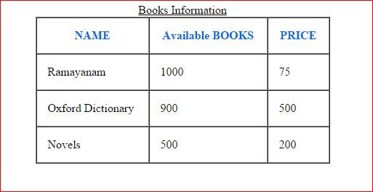

Html table example
Html table

Slide 17
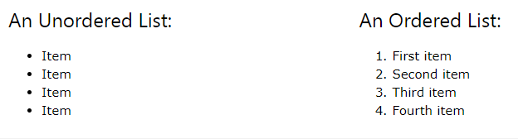
HTML Lists:
Unordered HTML List
An unordered list starts with the <ul> tag.
Each list item starts with the <li> tag.
Ordered HTML List
An ordered list starts with the <ol> tag.
Each list item starts with the <li> tag.

Slide 18
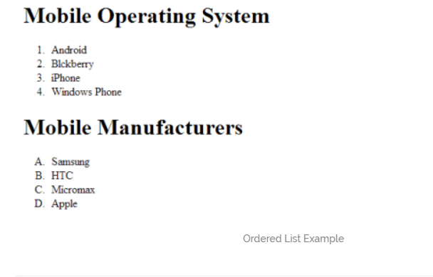
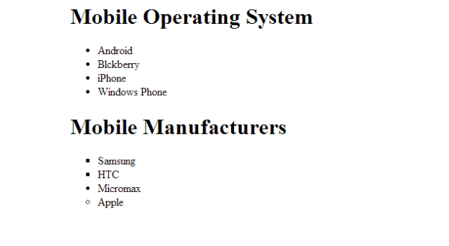
List example
Ordered list
Unordered list

Slide 19
HTML Forms:
The HTML <form> element defines a form that is used to collect user input.
The action attribute defines the action to be performed when the form is submitted.
The method attribute specifies the HTTP method (GET or POST) to be used when submitting the form data:

Slide 20
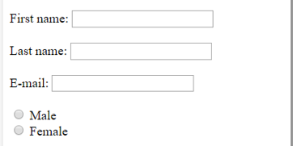
Html form example
Html form

Slide 21
INPUT Tag:
The <input> element is the most important form element.
The <input> element can be displayed in several ways, depending on the type attribute.
Ex:
Button,checkbox,color,date ,datetime-local ,email ,file,hidden,image,month ,number ,password,
Radio,range ,reset,search,submit, tel ,text,time ,url week

Slide 22



Html and css example
Html without Css
Html with Css

Slide 23
CSS

Slide 24
Styling HTML with CSS:
CSS stands for Cascading Style Sheets.
CSS describes how HTML elements are to be displayed on screen or in other media.
CSS can be added to HTML elements in 3 ways:
Inline - by using the style attribute in HTML elements
Internal - by using a <style> element in the <head> section
External - by using an external CSS file

Slide 25
Inline CSS:
An inline CSS is used to apply a unique style to a single HTML element.
An inline CSS uses the style attribute of an HTML element.
This example sets the text color of the <h1> element to blue:
<h1 style="color:blue;">This is a Blue Heading</h1>

Slide 26
Internal CSS:
An internal CSS is used to define a style for a single HTML page.
An internal CSS is defined in the <head> section of an HTML page, within a <style> element.
<style> body {background-color: powderblue;} h1 {color: blue;} p {color: red;} </style>

Slide 27
External CSS:
An external style sheet is used to define the style for many HTML pages.
To use an external style sheet, add a link to it in the <head> section of the HTML page:
<link rel="stylesheet" href="styles.css">

Slide 28
The id Attribute:
To define a specific identity for one special element, add an id attribute to the element:
<p id="p01">I am different</p>

Slide 29
The class Attribute:
To define a identity for elements, add a class attribute to the element:
<p class="error">I am different</p>

Slide 30
Some Common CSS Properties:
color
font-family
font-size
margin
padding
height
width
background-image
text-align
background-image
More at:
https://www.w3schools.com/cssref/

